Slide 1

Work place culture
Measuring and understanding
Prof Rica Viljoen

Slide 2
Layout of presentation
How to achieve sustainable organisational transformation through
Inclusivity
Introduction
Transformation
Theory on Engagement and Inclusivity
Unleashing tacit potential in systems
Benefits of Inclusivity
Benchmark of Engagement (BeQ)
Case study: Ghana, Australia, South Africa
How to create Engagement in organisations
Conclusions
Questions

Slide 3
Topic Description
Sustainable Organisational Change through Inclusivity
In today’s competitive, ever changing world, companies strive harder than ever to implement strategy in a sustainable manner and to stay recent in the mind of the global consumer.
Leaders in organisations should understand the art of facilitating employee engagement, thus unleashing the energy in the system to perform.
Inclusivity is a radical organisational methodology that can be used to facilitate sustainable organisational transformation.

Slide 4
Inclusivity Defined
“…a radical organisational transformational methodology which aligns the doing and the being side of the organisation around commonly defined principles and values, co-created by all.
It is a systemic approach that focuses on underlying beliefs and assumptions and challenges patterns in the individual, group and organisational psyche, to spend energy and engage in a sustainable, inclusive manner with the purpose to achieve shared consciousness.”

Slide 5
Organisational Transformation through Inclusivity
Sustainability thorough Inclusivity - energy on all dimensions
EQ Journey
Individual
OD Interventions
State Engagement
Trait Engagement
Behavioral Engagement
Dialoguing
Group
Leadership
Work attributes
Appreciative Inquiry
Storytelling
Organisation
Organisational Leadership
Trust
World Cafe
The What
Engagement
Doing
Context:
Industry
South Africa
Africa
Global
Leadership
The
Individual
How individuals
change
Apathy
The
Team
Inclusivity
Disconnect
The
Organisation
Being
How groups change
How organisations
change
The way: How we change
Why we change
Essence of Change
We change differently
New world of work
New
Sciences
Consciousness
Nature of the world

Slide 6

Studying culture in mining
Total: More than 50000
122
223
136
1997
393
239
1693
302
2907
2540
894
2237
3890

Slide 7
Engagement Defined
Employee Engagement is defined (Corporate Leadership Council, 2004:3) as
the “positive emotional connection to an employee’s work, thus affective, normative and continuance commitment” and "a heightened emotional connection that an employee feels for his or her organisation, that influences him or her to exert greater discretionary effort to his or her work".

Slide 8
Engagement Defined
Viljoen (2008) defined Engagement as
“Engagement, the systemic result of the interplay between the individual potential, group potential and organisational potential in the context of the specific industry or national culture”.
“as the output of the energy in the system to perform.”
The I-engage define behavioural engagement as defined by Macey (2008)

Slide 9
The business case of Employee engagement
Business Case for Engagement
Companies with high levels of employee engagement improved 19.2% in operating income while companies with low levels of employee engagement declined 32.7% (Towers Watson).
If organisations increased investment in a range of good workplace practices which relate to engagement by just 10%, they would increase profits by $2,400 per employee per year (IES/Work Foundation Report).
Increased employee engagement was accompanied by a 12% increase in stakeholder satisfaction and significant double‐digit revenue and margin growth over the past three years (Serco Study).
Engaged organisations grew profits as much as three times faster than their competitors. They report that highly engaged organisations have the potential to reduce staff turnover by 87% and improve performance by 20%. (Corporate Leadership Council)

Slide 10
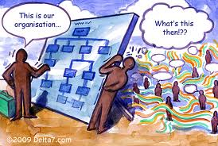
Understanding underlying beliefs in the system
Understanding the underlying beliefs in a system

Slide 11
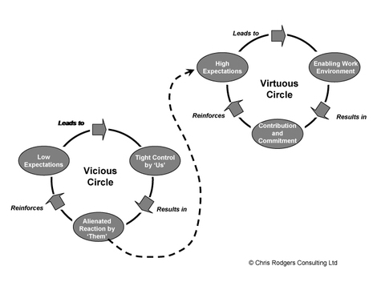
Building sustainable businesses
Building sustainable architecture
Vicious Cycle:
Disengagement
Absenteeism
Staff Turnover
Apathy
Low morale
Negative Behaviour
Poor service delivery
Incidents and accidents
Virtuous Cycle:
Unleashing voice
Productivity
Staff Retention
Employee Satisfaction
Creativity / Innovation
Value based behaviour
Customer Experience
Safe behaviour
Stakeholder Experience
Disconnected
30%-44%
Apathetic
45-59%
Involved
60-74%
Engaged
> 75%
Re-wiring the organisation to have innate momentum to perform sustainably

Slide 12



Constructs for the BeQ
Within the context of the country:
Assumptions
About
Me
Respect
Self Regard
Resilience
Personal Responsibility
Corporate Citizenship
I-Engage
Assumptions
About
We
Support
Leadership
Alignment,
Valuing Diversity
Accountability
We-Engage
Assumptions
About
They
Trust
Business Orientation
Adaptability to change
Inclusivity
Ethics
They-Engage

Slide 13
Benefits of Engagement
Level of
engagement
Correlates directly to:
+ -
Productivity Abseetism
Retention Turnover
Employee Satisfaction Apathy
Creativity and Innovation Number of incidents
Safe Behaviour Number of Accidents
Customer experience Mistakes
Ability to deal with change Apathy

Slide 14
Human Capacity in the system to perform
National Cultural
Assumptions
About
Me
The
individual
Assumptions
About
We
Level of
engagement
The
Team
The
Organisation
Assumptions
About
They
and Society Context

Slide 15
National Cultural Diversity
Notes:
Why FMS slide 1 HME strategy
What we learn from the visit.
How to implement
Slide 2 - Who took part
Where did we go
Slide 3 to 9 visit A
Where, who mine, what system, key learning
Slide what did we prefer. Surface and underground reason for
Slide on key implementation drivers
Comms and backbone
URS
FRS
Allowance for other systems
Slide 10 control rooms
Operation of system
Slide 11
Value add to other systems/building blocks
OEE , PM, MMRS
Framework slide
Way forward
Approval at Exco
Infrastructure analysis
Project management
Change management, training, etc
FRS

Slide 16
Interrelatedness of African Purple
BeQ™ Laubscher’s Human Niches
Family Relations
Rules of Behaviour
Ceremonial/Ritual
Time Orientation
Secrecy
Social Structure
Copying
Drumming, Dancing, Art, Storytelling
Relationships
Elders
Old ways
People Relations
Exists outside past or future
Human Domain
Consultation Communication Harmony
Stories
Animals
Sacred/Spiritual Domain
Physical Domain
Storytelling and Metaphors
Ancestors
Animal Spirit
Sky
White/Black Magic
Honoring and Protection
Land
Sun, Moon, Stars and Wind
Sangomas
Foresight
Healing
Gift of gods
Sacred earth

Slide 17
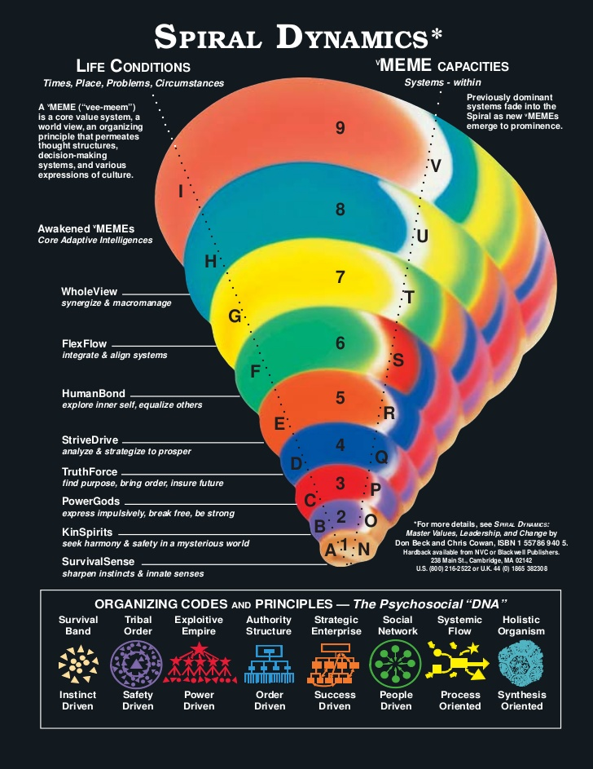
Human Niches
BeQ™ Laubscher’s Human Niches
Dr. Graves's Emergent, Cyclical Levels of Existence Theory Applied
Exists outside past or future
Consultation Communication Harmony
Storytelling and Metaphors
53%
18%
20%
6%
3%
Animal Spirit
Sun, Moon, Stars and Wind
Gift of gods
Sacred earth

Slide 18
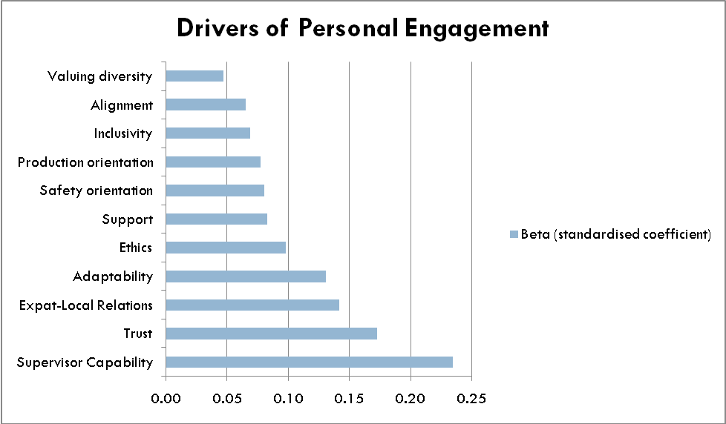
Drivers of Engagement
The Ghana formula: Drivers of I-Engage

Slide 19
The soil needs the seed and the seed needs the soil
One only has meaning with the other.
The same thing happens to human beings.
When male knowledge comes together with female transformation, then the great magical union takes place, which is called Wisdom.
Paulo Coelho
The Doing and The Being

Slide 20
Shifts in underlying behaviour based safety beliefs
Behaviour Based Safety Beliefs

Slide 21
Quantitative statistical analysis
I-engage formula
Factor analysis and regression
Ghana_I-ENGAGE =
=.26*TEAMWORK (INTRA AND INTER TEAM)+ 24*SUPERVISION+
.18*RESPECT
+.13*BEING CONSULTED+.11* TRUST +.2
Australia I-ENGAGE =
28*CONNECTION + .21*SUPERVISOR SKILL (DOING AND BEING)
+ .19*TEAMWORK +. 13*FAIRNESS +.18
Peru ENGAGE =
.22*CARING + .21*CONNECTION +.17*ALIGNMENT (DOING)
+ .15*LEADERSHIP EXAMPLE +.15*SUPPORT +.10
South Africa I_ENGAGE =
= .222*SUPPORT + .151*DIVERSITY + .130*SUPERVISION + 2.342

Slide 22
The BeQ Narrative Told
BeQ Narrative Told
If you want to walk fast, walk alone; if you want to walk far, walk together
Decreased self
worth & self regard –
low confidence
(skill erosion impact)
Even stronger
alignment & focus
on Safety
Perception that
company is
not responsive
More willingness to
persevere & commit
due to increased
opportunity to grow
Loss of voice – don’t
feel heard/consulted
Discrepant valuing
between production
& support roles
Low rewards
Higher intra and more
inter-departmental
teamwork & support
Tolerance of
underperformance –
nepotism
Improved
Performance
Feedback provided
Impacts on
sustainable ability
to perform over time
Inconsistent/unfair
dept performance
management practices
Willingness to
Develop/Improve
skills to add more value
Low supervisory soft
skill – motivation,
acknowledgement
Willing, yet
frustrated & concerned
system – please hear the
concers we raise –
we want to help
Stronger drive to
improve efficiencies &
drive to align to values
Low loyalty
Evident Enablers Outcome Compromisers Manifested Dynamic

Slide 23
Quantitative statistical analysis
I-engage formula
Factor analysis and regression
Ghana I-ENGAGE =
=.26*TEAMWORK (INTRA AND INTER TEAM)+ 24*SUPERVISION+
.18*RESPECT
+.13*BEING CONSULTED+.11* TRUST +.2
Australia I-ENGAGE =
28*CONNECTION + .21*SUPERVISOR SKILL (DOING AND BEING)
+ .19*TEAMWORK +. 13*FAIRNESS +.18
Peru I-ENGAGE =
.22*CARING + .21*CONNECTION +.17*ALIGNMENT (DOING)
+ .15*LEADERSHIP EXAMPLE +.15*SUPPORT +.10
South Africa I-ENGAGE =
= .222*SUPPORT + .151*DIVERSITY + .130*SUPERVISION + 2.342

Slide 24
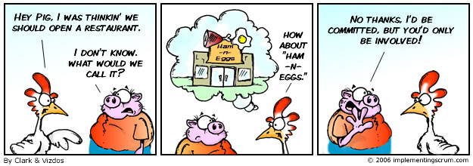
Engaged!
Mind the gap!!!!
Notes:
24
24

Slide 25
To focus on:
Global value based leadership for the future
Measure Engagement and determine ROI of interventions
Through scientific diagnostic cultural sensitive longitudinal validated instruments
2. Release voice
“The most important thing is not the script but the story”
3. Listen with your eyes closed
“The best leader is the one who listens the best to the total organisation”
4. Speak in colours / frequencies
Translate for understanding and human niche
5. Remember what made us successful in the first place
“If you want to move forward, look back, look back…”
6. Position the people agenda as part of any strategic conversation
“Incorporate Safety, HR, Internal Branding and External Positioning strategies in line strategy”
Integrate
“I would do anything for the simplicity at the other side of complexity”

Slide 26
Questions
Questions
?
Notes:
26
26

Slide 27
References
References
Agarwala, T. 2003, ‘Innovative human resource practices and organisational commitment: An empirical investigation’, International Journal of Human Resource Management, vol. 14, no. 2, pp. 175-197.
Allen, N.J. & Meyer, J.P. 1990, ‘The measurement and antecedents of affective, continuance and normative commitment to the organisation’, Journal of Occupational Psychology, vol. 63, pp. 1-18.
Angle, H.L. & Perry, J.L. 1986, ‘Dual commitment and labour- management relationship climates‘, Academy of Management Journal, vol. 29, no. 1, pp. 31-50.
Angle, H.L. & Perry, J.L. 1983, ‘Organisational commitment: Individual and organisational influences‘, Work and Occupations, vol. 10, no.2, pp. 123-146.
Baruch, Y. & Winkelmann-Gleed, A. 2002, ‘Multiple commitments: A conceptual framework and empirical investigation on a Community Health Service Trust‘, British Journal of Management, vol. 13, pp. 337-357.
Benson, J. 1998, ‘Dual commitment: Contract workers in Australian manufacturing enterprises’, Journal of Management Studies, vol. 35, no. 3, pp. 355-375.
Bishop, J.W. Dow Scott, K. & Burroughs, S.M. 2000, ‘Support, commitment, and employee outcomes in a team environment’, Journal of Management, vol. 26, no. 6, pp. 1113-1132.
Blau, P.M. 1964, Exchange and Power in Social Life, Transaction Publishers, New Brunswick, New York.
Notes:
27
27

Slide 28
References
References
Chang, K. & Chelladurai, P. 2003, ‘Comparison of Part-time workers and Full-time workers: Commitment and citizenship behaviours in Korean sport organisations’, Journal of Sport Management, vol. 17, pp. 394-416.
Crabtree, S. 2005, ‘Engagement keeps the doctor away‘, Gallup Management Journal, January 13, pp. 1-4.
Deery, S.J. & Iverson, R.D. 1998, ‘Antecedents and consequences of dual and unilateral commitment: A longitudinal study‘, The University of Melbourne, Department of Management working paper number 1, January 1998.
Echols, M.E. 2005, ‘Engaging employees to impact performance‘ Chief Learning Officer, February, pp. 44-48.
Eisenberger, R. Fasolo, P & Davis-LaMastro, V. 1990, ‘Perceived organisational support and employee diligence, commitment and innovation‘, Journal of Applied Psychology, vol. 75, no. 1, pp. 51-59.
Eisenberger, R. Huntington. R. Hutchinson, S. & Sowa, D. 1986, ‘Perceived organisational support‘, Journal of Applied Psychology, vol. 71, no. 3, pp. 500-507.
Gouldner, A.W. 1960, ‘The norm of reciprocity. American Sociological Review, vol. 25, no. 2, pp. 165-178.
Greenfield. W.M. 2004, ‘Decision making and employee engagement‘, Employee Relations Today‘, Summer, pp. 13-24.
Gubman, E. 2004, ‘From engagement to passion for work: The search for the missing person‘, Human Research Planning, pp. 42-46.
Notes:
28
28

Slide 29
References
References
Harter, J.K. Schmidt, F.L. & Hayes, T.L. 2002, ‘Business- unit- level relationship between employee satisfaction, employee engagement, and business outcomes: A meta analysis‘, Journal of Applied Psychology, vol. 87, no. 2, pp. 268-279.
Kahn, W.A. 1990, ‘Psychological conditions of personal engagement and disengagement at work‘, Academy of Management Journal, vol. 33, no. 4, pp. 692-724.
Luthans, F. & Peterson, S.J. 2002, ‘Employee engagement and manager self-efficacy: Implications for managerial effectiveness and development‘, Journal of Management Development, vol. 21, 5, pp. 376-387.
May, D.R. Gilson, R.L. & Harter, L.M. 2004, ‘The psychological conditions of meaningfulness, safety and availability and the engagement of the human spirit at work’, Journal of Occupational and Organizational Psychology, vol. 77, PP. 11-37.
Macey, W.H. & Schneider, B. 2008. ‘The meaning of employee engagement’ , Industrial and Organisational Psychology, vol, 1, pp 3-30.
McDade, S. & McKenzie, A. 2002, ‘Knowledge workers in the engagement equation’, Strategic HR Review, vol. 1, 4, pp. 34-37.
Meyer, J.P. & Allen, N.J. 1991, ‘A three component conceptualisation of organisational commitment’, Human Resource Management Review, vol. 1, pp. 61-89.
Notes:
29
29

Slide 30
References
References
Mowday, R.T. Steers, R.M. & Porter, L.W. 1979, ‘The measurement of organizational commitment, Journal of Vocational Behaviour, vol. 14, pp. 224-247.
Mueller, C.W. Wallace, J.E. & Price, J.L. 1992, ‘Employee commitment: Resolving some issues‘, Work and Occupations, vol. 19, no. 3, pp. 211-236.
Porter, L.W. Steers, R.M., Mowday, R.T. & Boulian, P.V. 1974, ‘Organizational commitment, job satisfaction, and turnover among psychiatric technicians’, Journal of Applied Psychology, vol. 59, no. 5, pp. 603-609.
Price, J.L. & Mueller, C.W. 1986, Handbook of organizational measurement, Pitman Publishing, INC, Massachusetts.
Price, J.L. & Mueller, C.W. 1981, ‘A causal model of turnover for nurses‘, Academy of Management Journal, vol. 24, no. 3, pp. 543-565.
Robinson, D., Perryman, S. & Hayday, S. 2004, ‘The drivers of employee engagement‘, Institute of Employment Studies, Report 405.
Viljoen, R.C. 2008, ‘Sustainable organisational transformation through inclusivity’, DBL dissertation. Available online www://etd.unisa.ac.za/ETD-db/theses/available/etd-02192009-090759/unrestricted/00thesis.pdf
Notes:
30
30

